Slide 1


The DE
Lifecycle:
Python Edition
Technical Lesson

Slide 2
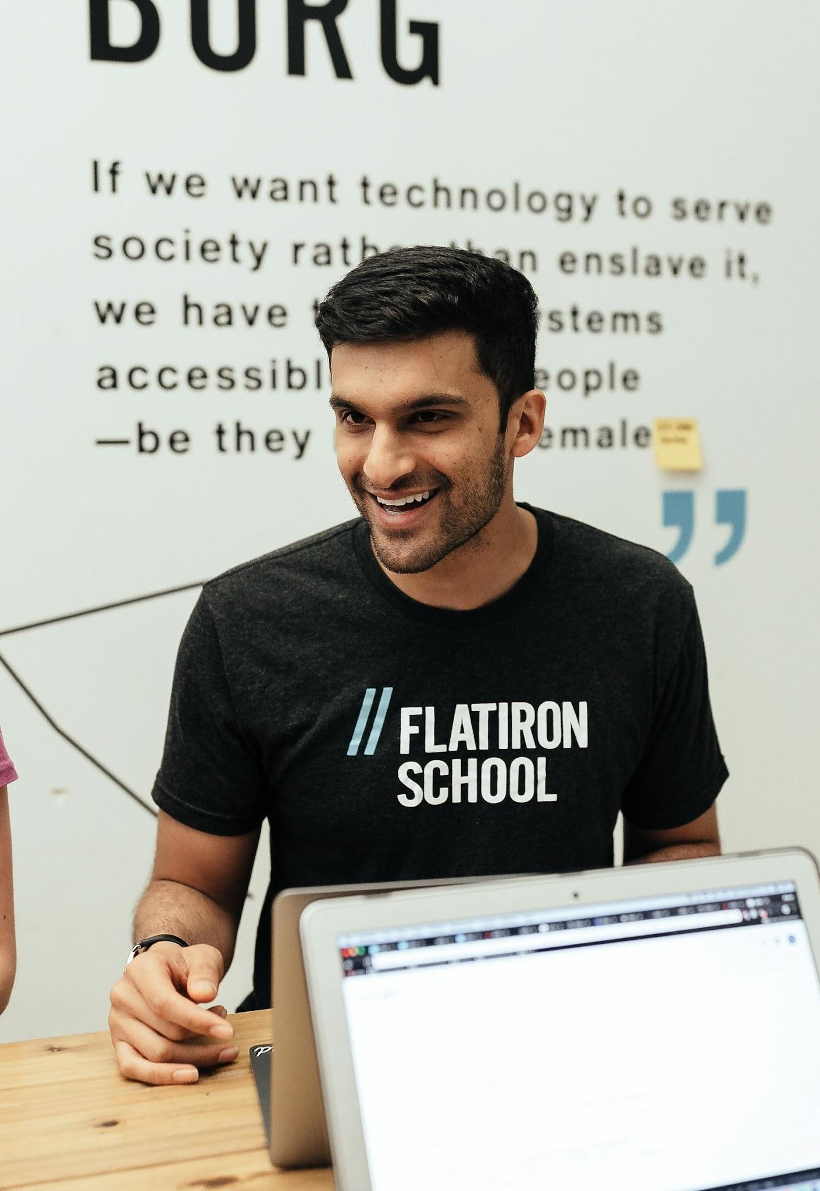
Agenda
Generate Data
Store Data
Ingest Data
Transform Data
Serve Data

